Slide 1
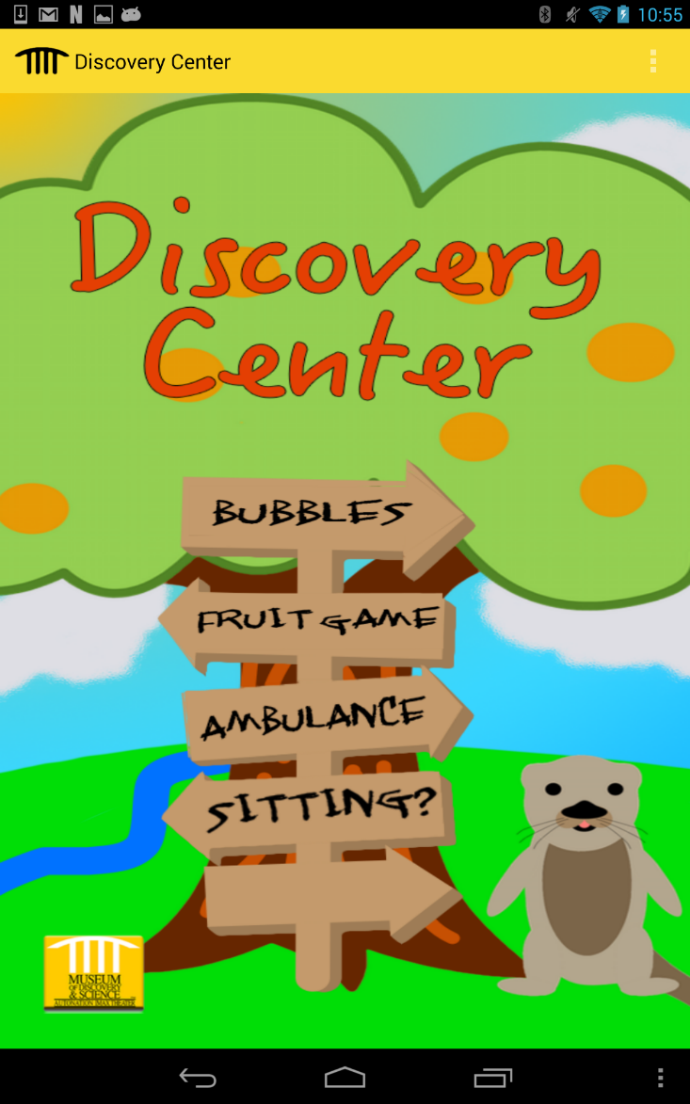
Main screen
This app is for the “Discovery Center” Exhibit.
It is made by Osmar Coronel and Steven Rodriguez
Since the Discovery Center is an exhibit that focuses on little children, we wanted to appeal to that type of demographic.
On the main screen we have a colorful background featuring Joey the Otter, an orange tree, and a sign that leads to all main attractions of the exhibit. The main screen also has very cheerful music in the background

Slide 2
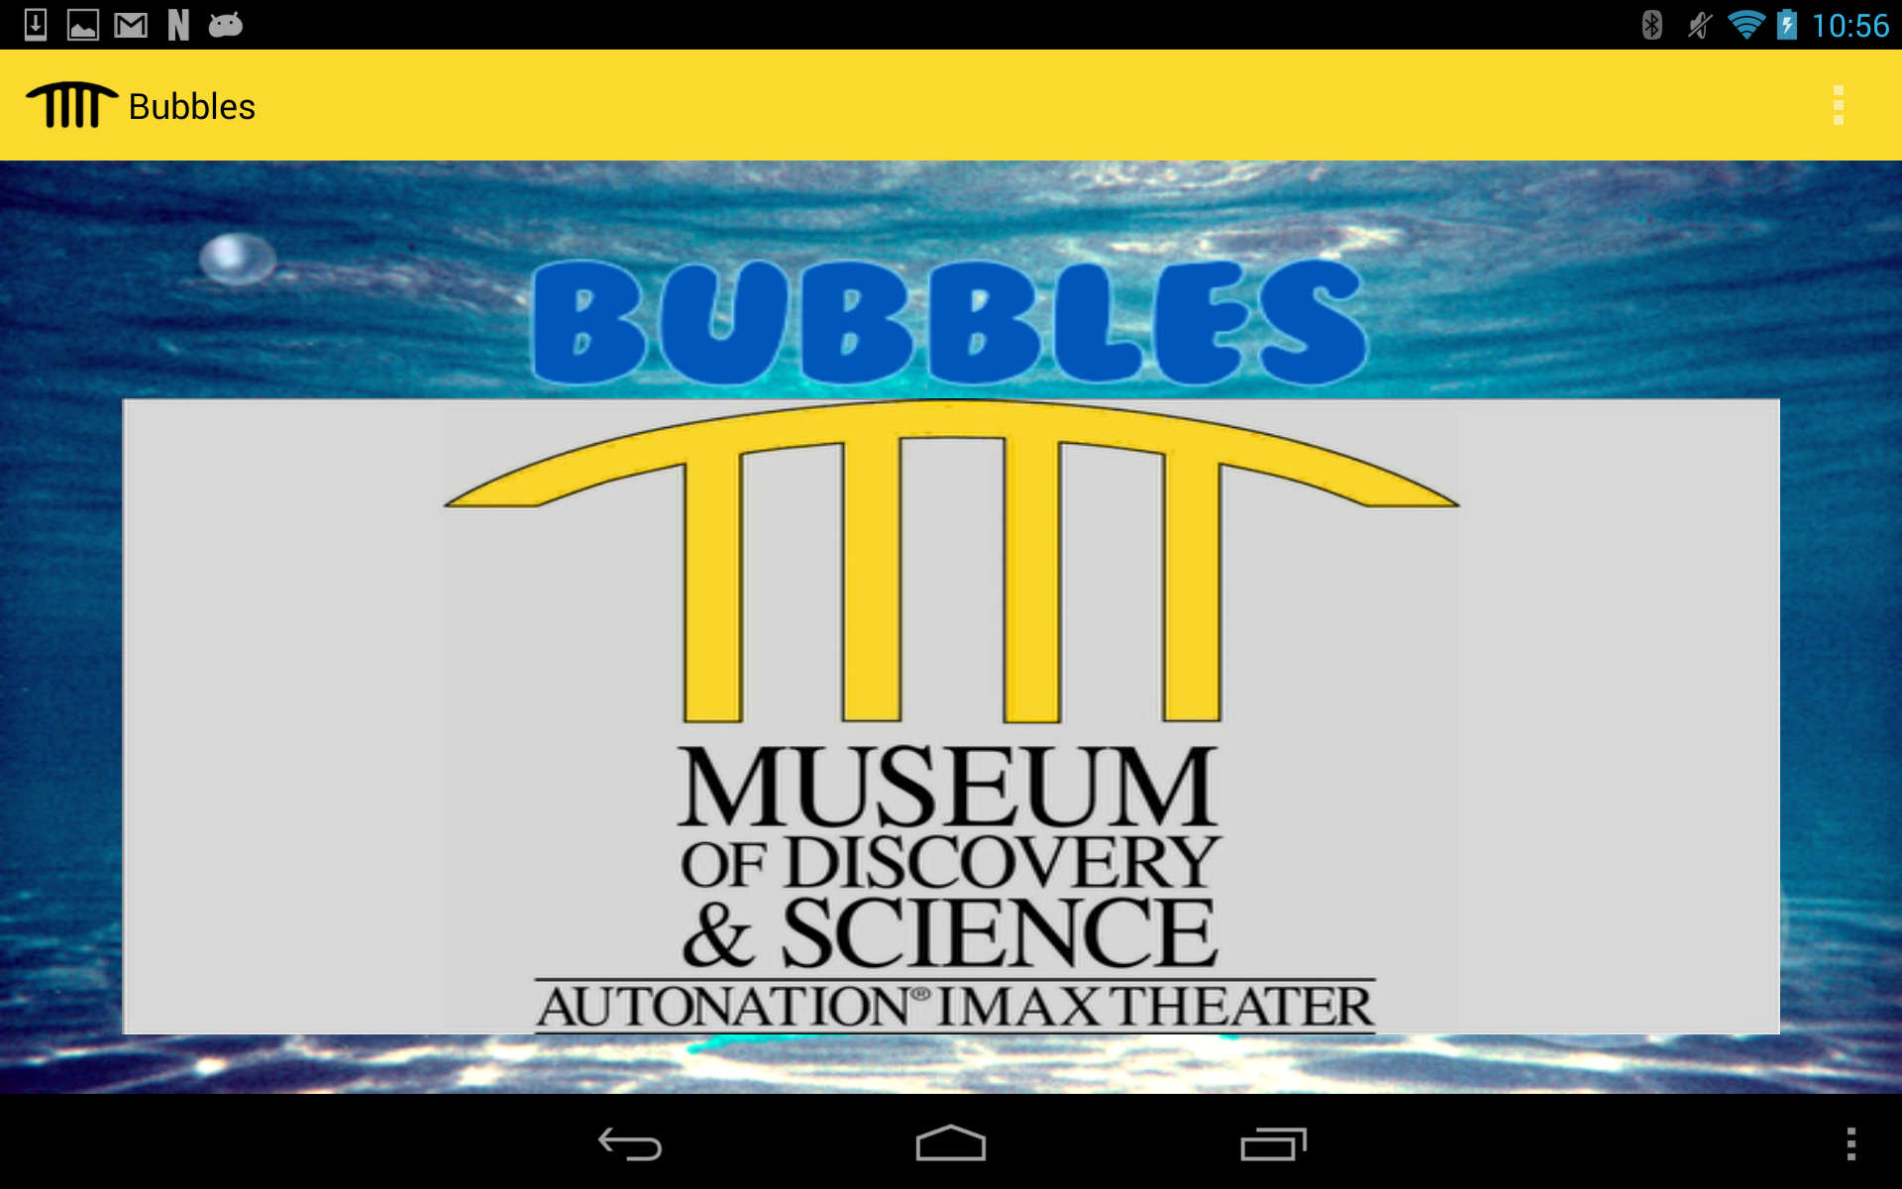
Bubbles
In the Bubbles screen, we have an underwater background with bubbles
Here we have a video that teaches kids how to use the small pool of soap and water to make bubbles

Slide 3
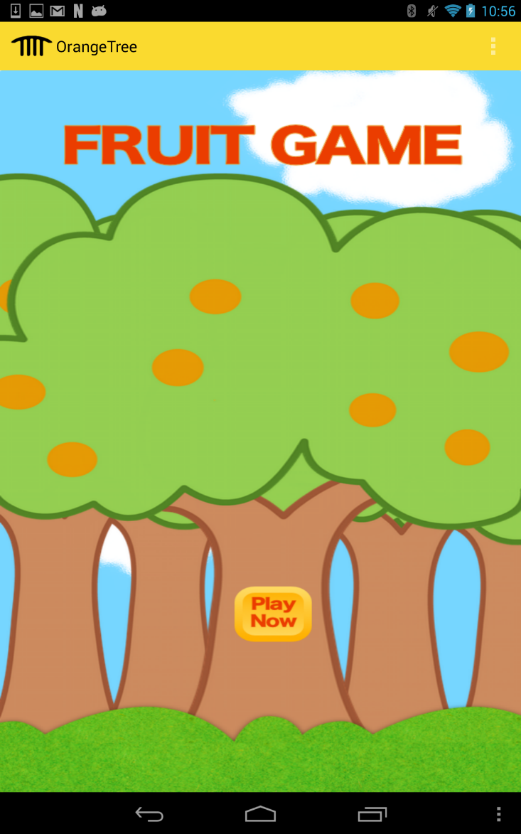
Fruit Game
In the Fruit Game screen, we have a background of a bunch of orange trees and a button that says Play Now
The button leads to our quiz game where it shows you a picture of a fruit and a list of answer choices, you have to find the correct name of the fruit shown to you.
You are able to choices your difficulty of Easy, Medium, or Hard and you are also able to choose what type of fruit you want to include of Melons, Stone Fruit, Citrus, Tropical Fruit, and Berries

Slide 4
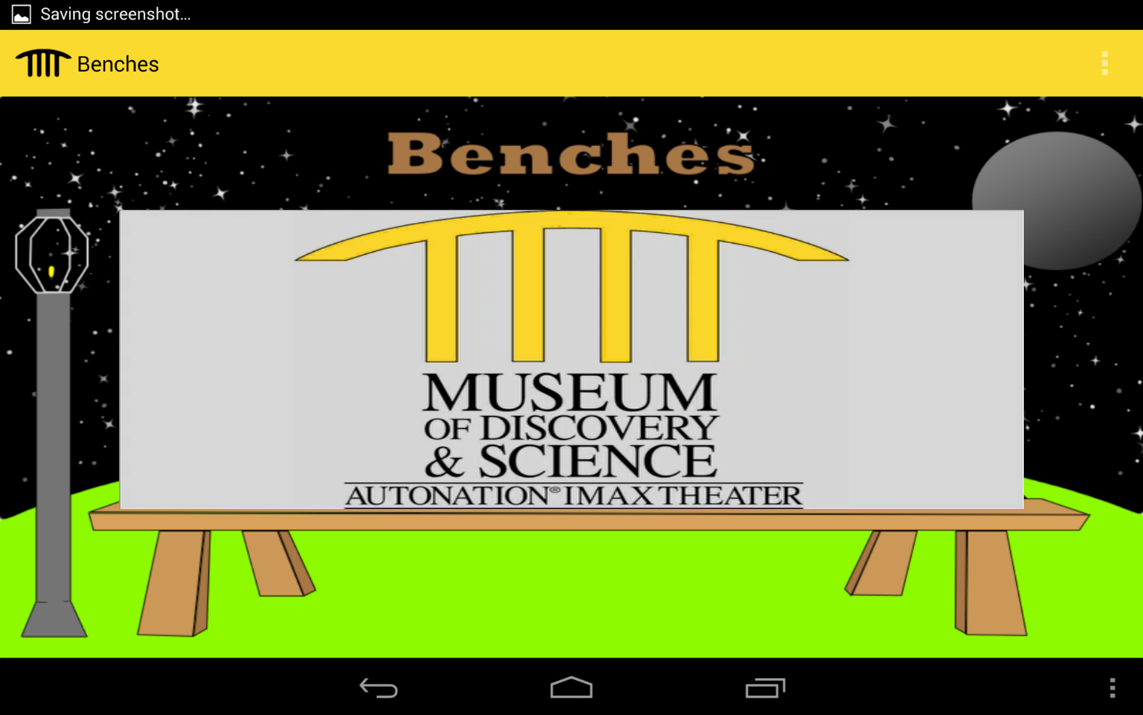
Sitting?
The Sitting screen has a background of space with a bench in the middle
In the middle of the bench has a video
In the video my partner, Osmar shows what the children and the parents with their children can do other than sit on the benches

Slide 5
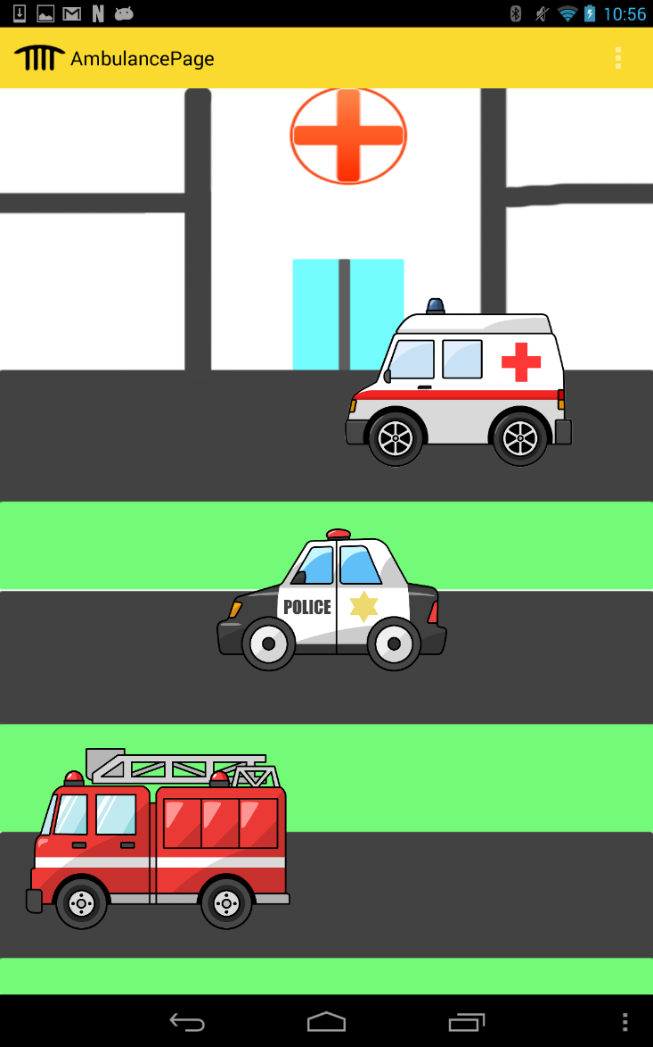
Ambulance
In the Ambulance screen we have a background of a hospital and a street
On the street we have three icons of an Ambulance, Police Car, and Firetruck
If you click on one of the three icons the noise that that vehicle makes is heard
This is there so that when the children play with the ambulance in the exhibit they can accompany their fun with the noise as well

